Slide 1
CELESTIAL MECHANICS
Judhistira Aria Utama, M.Si.
Program Magister Pengembangan & Pendidikan Astronomi
FMIPA ITB

Slide 2
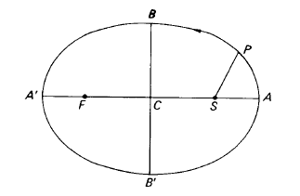
Elliptic Orbit
Then the line AA is the major axis of the ellipse, C is the centre and, therefore, CA and CA’ are the semi-major axes. Likewise BB is the minor axis, with CB and CB’ the semi-minor axes. If a and b denote the lengths of the semi-major and semi-minor axes respectively, then
b² = a²(1 − e²) and e = CS/CA
Find the perihelion & aphelion distance!

Slide 3
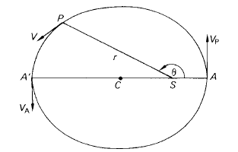
The velocity of a planet in its orbit
Let V_{P} & V_{A} be the velocities at perihelion A and aphelion A’ respectively. We may write:
V = rω
where ω is the angular velocity.

Slide 4
From Kepler’s second law:
r²ω = h
Hence, at perihelion and aphelion only, we have
V =h/r
For perihelion:
VP =h/a(1 − e)
For aphelion:
VA =h/a(1 + e)

Slide 5

Measuring the mass of a planet
Let a planet, P, with orbital semi-major axis a, sidereal period of revolution T and mass m possess a satellite, P₁, that moves in an orbit about P with semi-major axis a₁ and sidereal period of revolution T₁. Let the masses of the Sun and satellite be M and m₁ respectively.
From Kepler’s third law for circular orbit:
where
μ = G(m₁ + m₂)

Slide 6



For the planet and the Sun we have:
μ = G(M + m)
For the satellite and planet we have:
μ = G(m + m₁)
Dividing the later with previous one, we have:

Slide 7
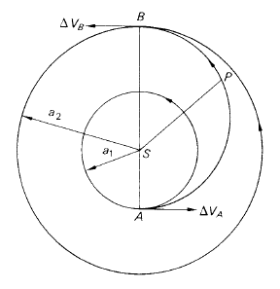
Transfer between circular, coplanar orbits about the Sun

Slide 8
The semi-major axis, α, of the transfer orbit.
From previous figure, it can be seen that:
AB = 2α = a₁ + a₂
Hence,
α = (a₁ + a₂) / 2
The eccentricity, e, of the transfer orbit.
SA = a₁ = α(1 − e)
SB = a₂ = α(1 + e)
Hence,
e = (a₂ − a₁) / (a₂ + a₁)

Slide 9


The transfer time, τ, spent in the transfer orbit.
The velocity increments V_{A} and V_{B}.
At A, the required increment ΔV_{A} is the
difference between circular velocity Vc₁ in the
inner orbit and perihelion velocity V_{P} in the
transfer orbit.
ΔV_{A} = V_{P} − Vc₁
or

Slide 10

At B, the required increment ΔV_{B} is the difference between circular velocity Vc₂ in the outer orbit and aphelion velocity V_{A} in the transfer orbit.
ΔV_{B} = Vc₂ − V_{A}, since Vc₂ > V_{A}
or

